Slide 1
FULL-CYCLE DIGITAL DEVELOPMENT TAILORED TO YOUR NEEDS

Slide 2
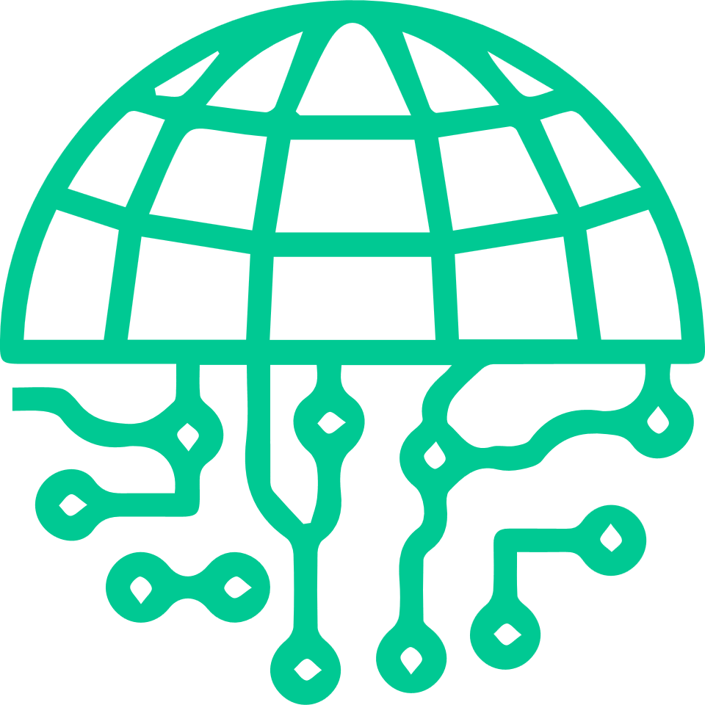
We value convenience, excellence, and great communication with each of our clients, and this is our primary focus every day of work.
ABOUT US
We are Nebulosa. A team of programmers and developers - a Cosmic Engine - with a specific focus on seamless collaboration, total transparency, and secure delivery for every project we undertake.
We help to create and lead opensource development technologies of the future.
We offer end-to end software services across a range of platforms and technologies.

Slide 3
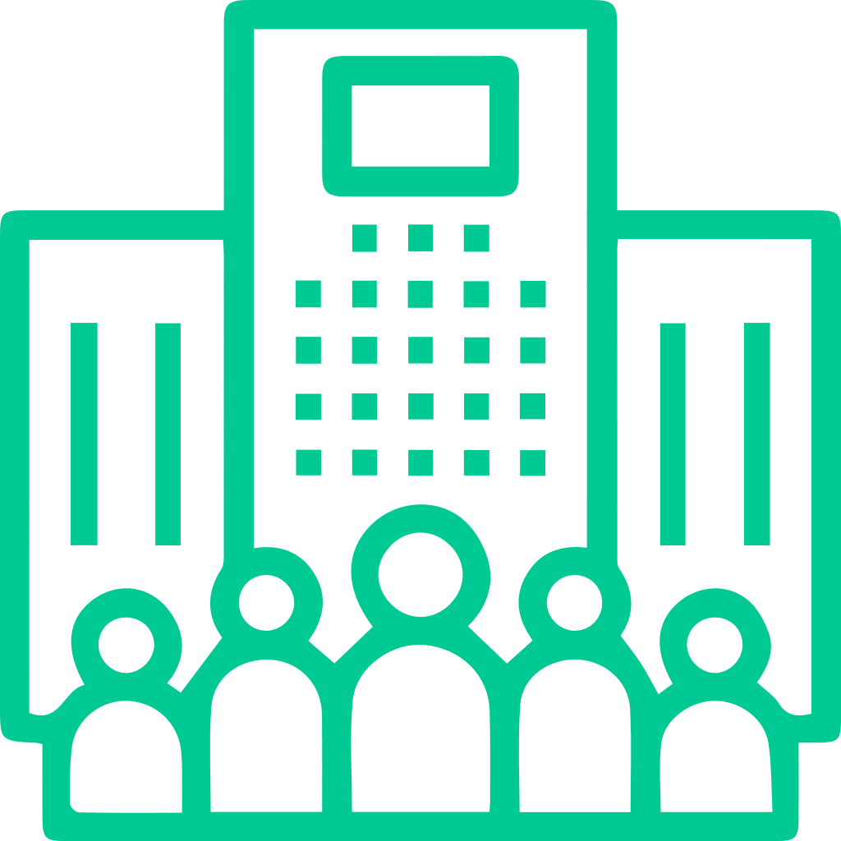
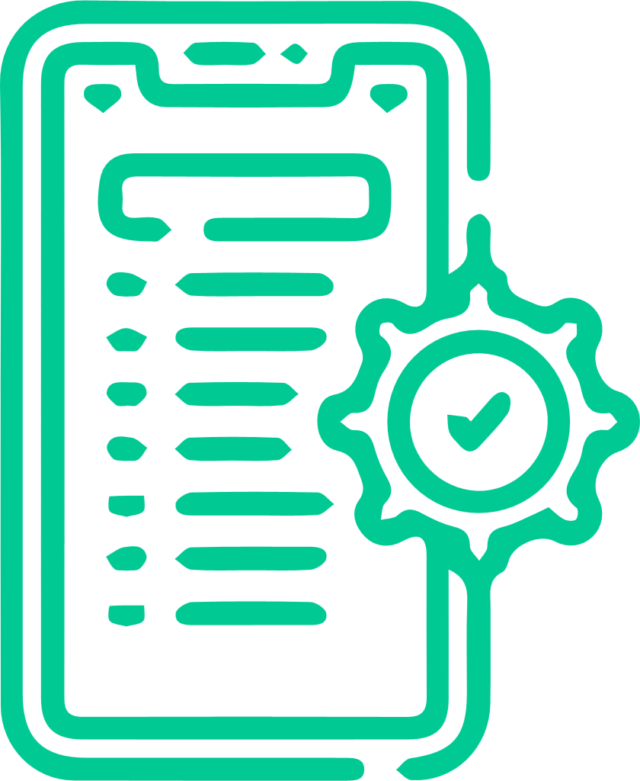
WHY US
We are a top employer in Mexico GDL - a state known for its technical excellence and precision.
Strategic Consulting
Full-service, Full-stack
Globally focused
Product Strategy
Enterprise Planning
Public
Cloud Optimization
Resource Augmentation
Web Development
Mobile Development
Quality Assurance

Slide 4
TECHNOLOGY TOOLS

Slide 5
PROJECT MANAGEMENT
STAFF AUGMENTATION
Our team can take care of all aspects of your digital product, from creation to testing to implementation.
Our staff augmentation service provides you with the extra resources you need to bring your project to life.
Want to expand your current portfolio to include digital products?
We can provide development support when you need it most, especially while backfilling roles within your team
Seeking to add new features to an existing and successful product?

Slide 6
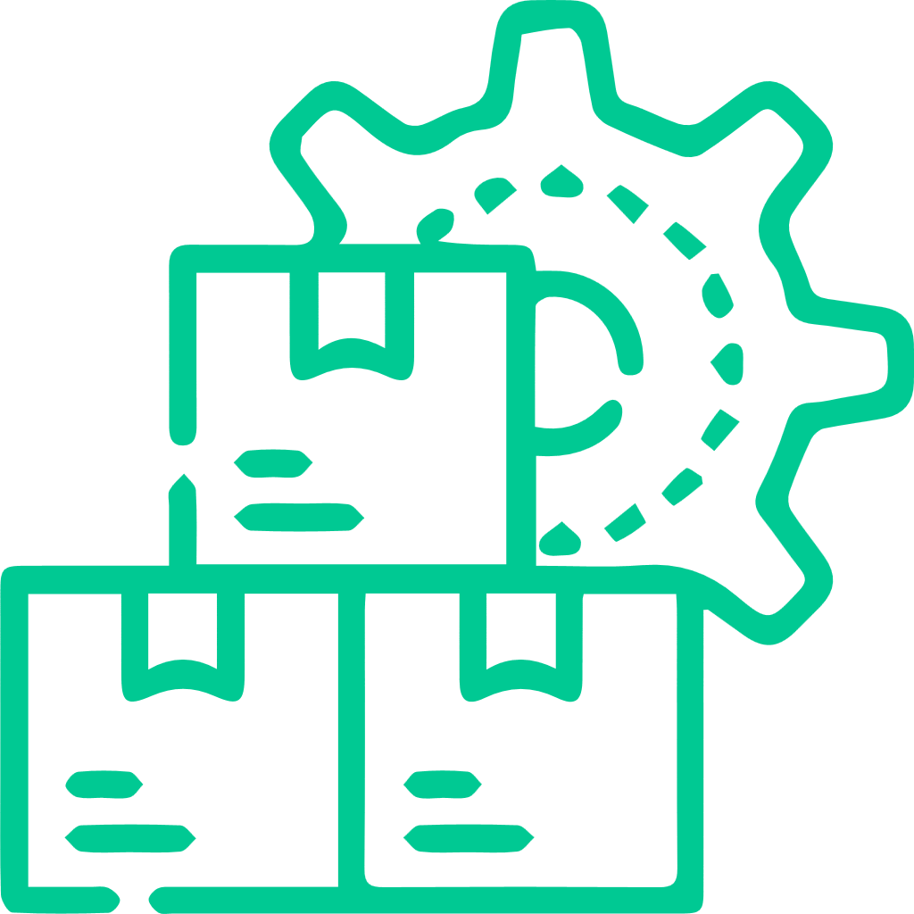
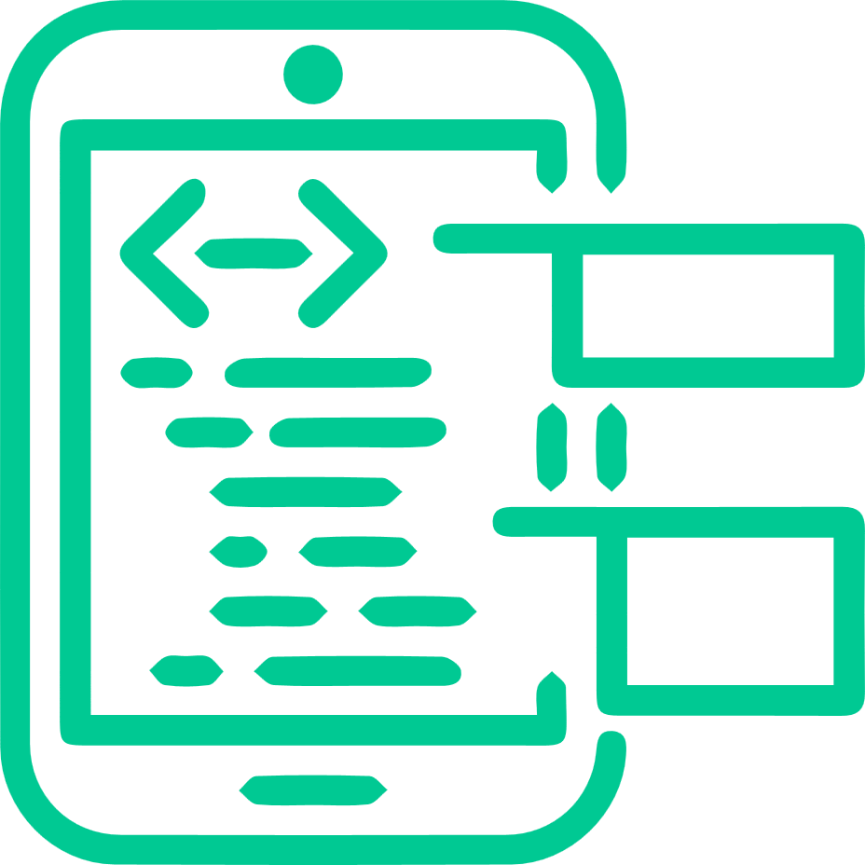
WEB DEVELOPMENT
Our website development team is experienced in both the front end and back end of website development so that you can engage your target audience with ease.
From back-end to front-end website development, we’ll leave you with a product that’s functional, effective and engaging to your end-users.
MOBILE ASSISTANCE & DEVELOPMENT
Smartphones, tablets, wearables – we assist you in following your users where they are with our carefully crafted mobile apps. Reach your clients via Android, iOS, or cross-platform solutions
iOS
App Development
Android
App Development
Flutter Development
React
Native Development

Slide 7
DESIGNING
Our design skills are varied to be able to assist you in every design project you may have.
From research and design of complex web and mobile experiences to illustration, motion design, and brand concept design - no matter what you need, we can help you bring it to life through our artistic, professional design capabilities.
Product Design
UX Design
Illustration
Consultancy

Slide 8
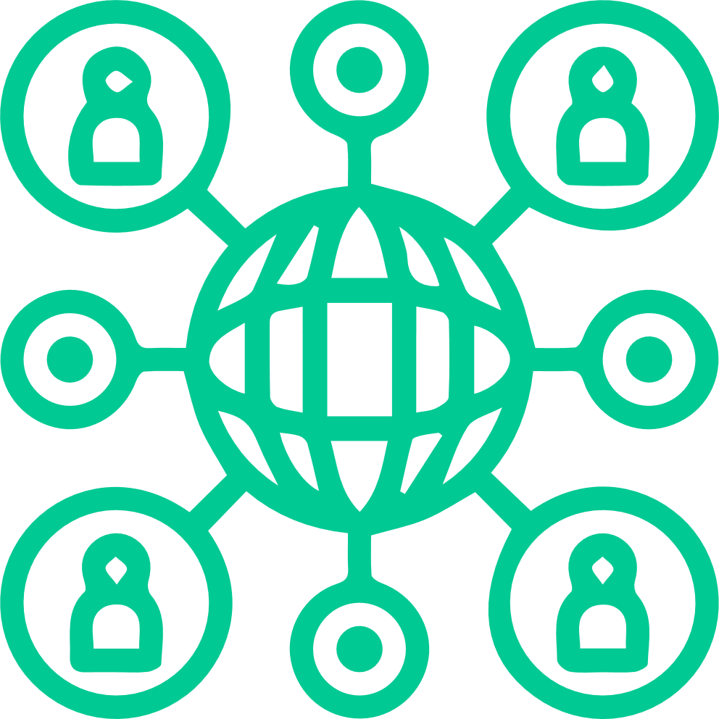
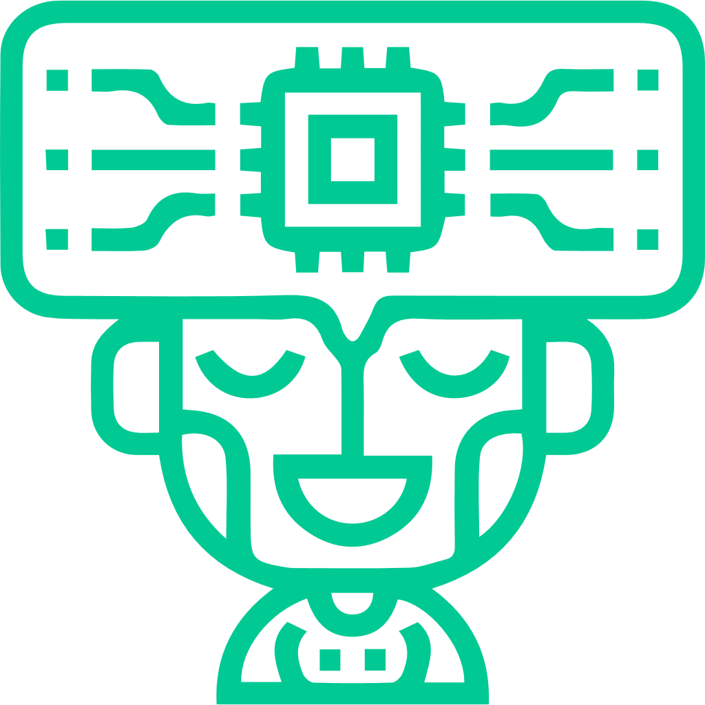
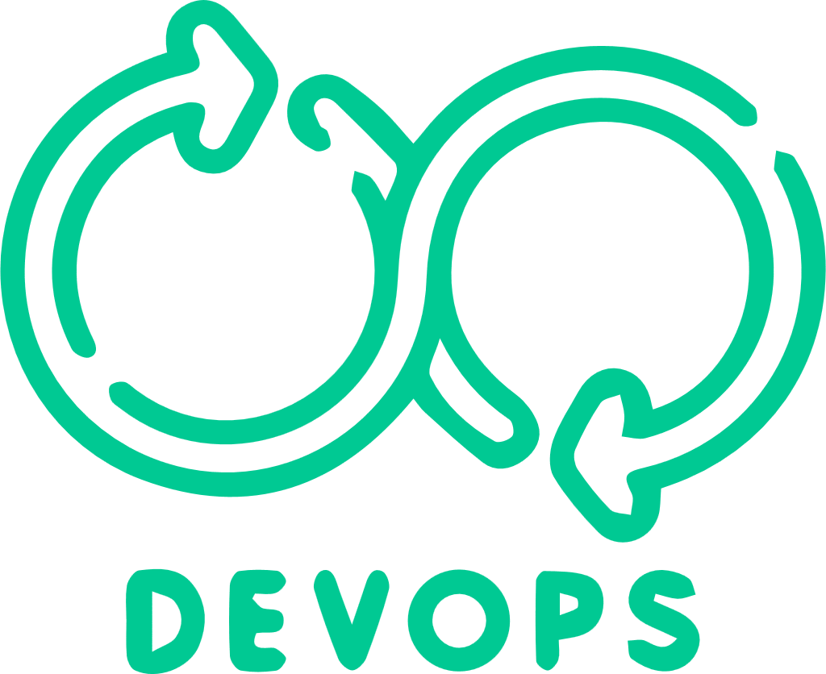
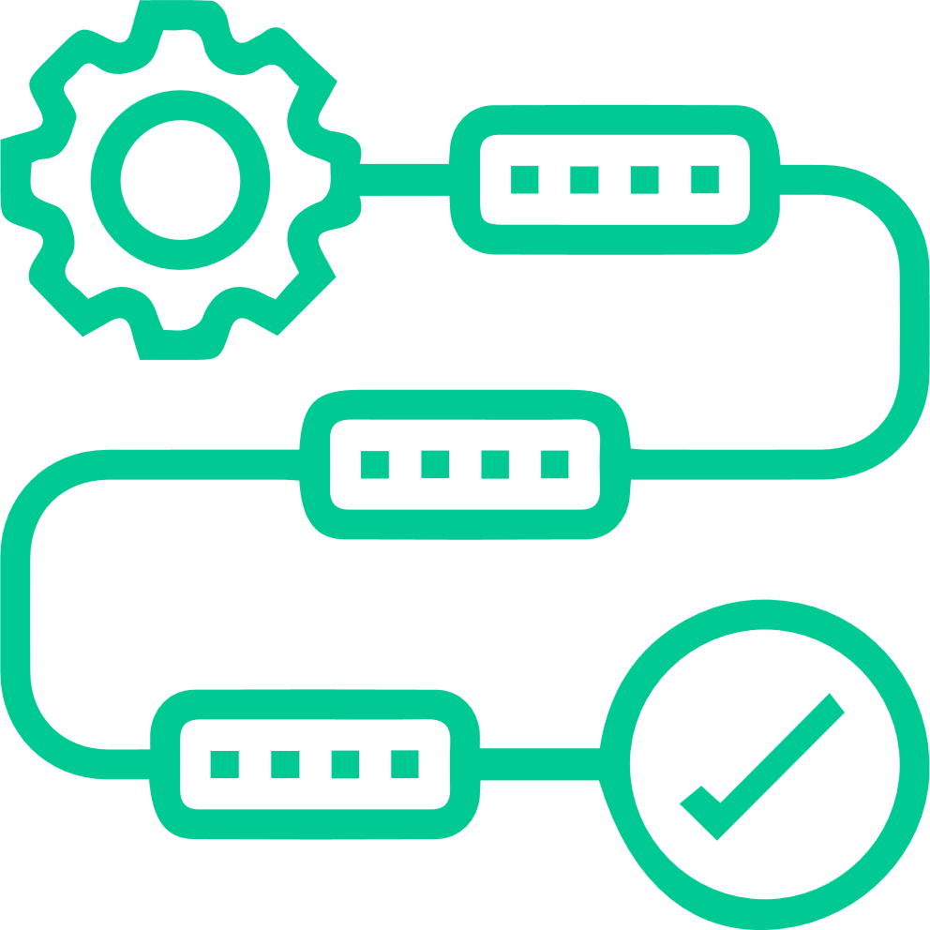
MACHINE LEARNING
We work with complex web and mobile experiences to help you serve and connect with your intended clients.
Deep
Neutral Networks
Natural
Language Processing
Face ID
Automatic
Speech Recognition
DEVOPS
Our team of developers works in combination with our operations team to create a highly reliable and available infrastructure for your project. By working in collaboration, we deliver the end product faster than our competitors.
Developing in DevOps Culture
Infrastructure
as a code
CI/CD Processes
Monitoring
and Maintenance

Slide 9
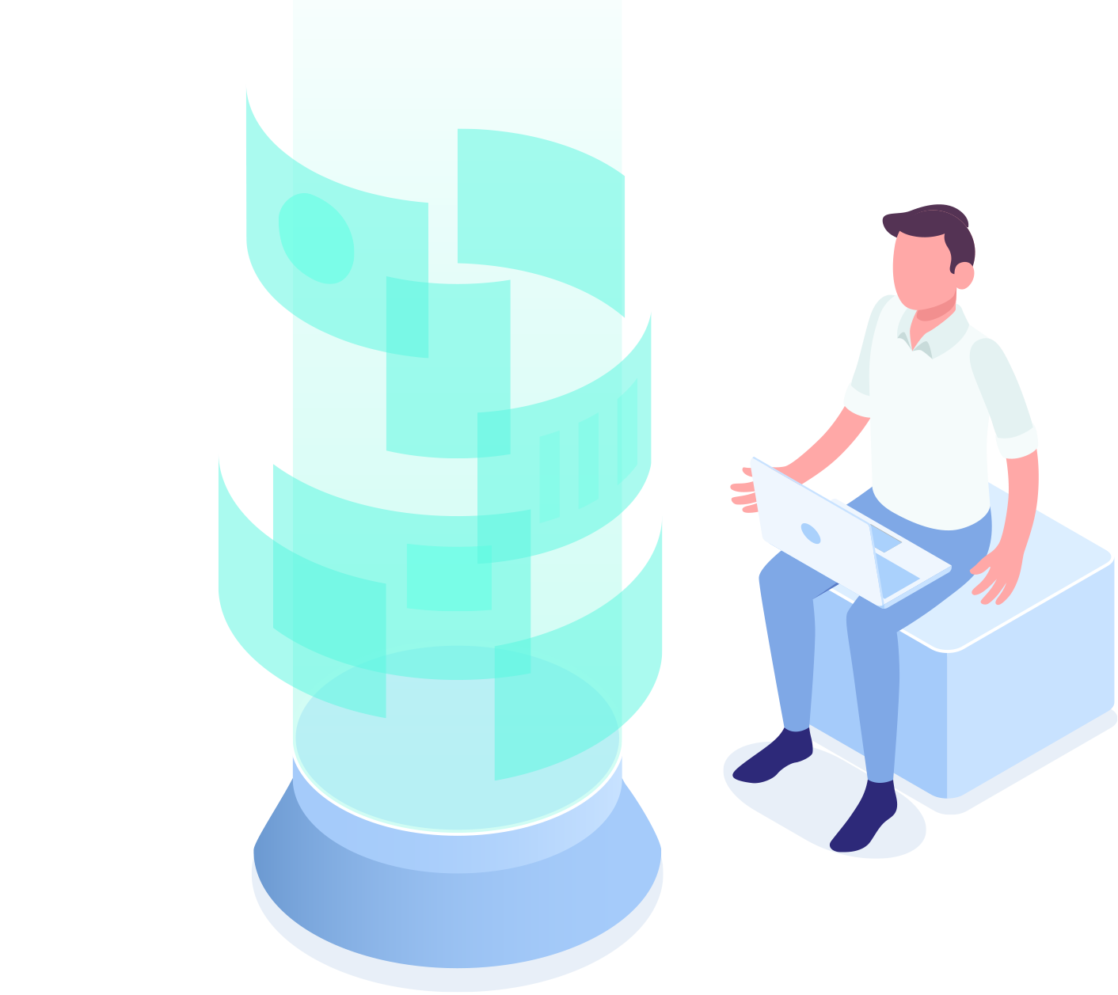
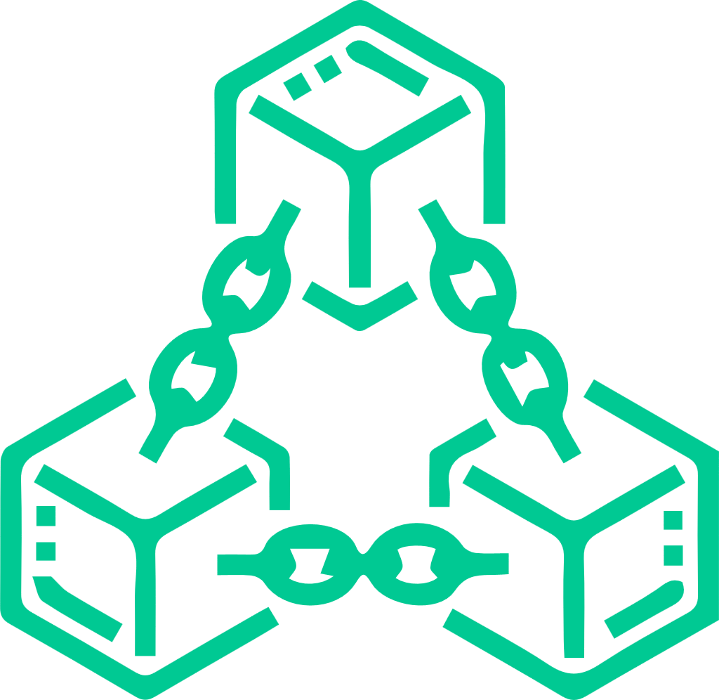
BLOCKCHAIN
Our team consists of experts in Blockchain to help our clients launch their DApp, Exchange, or Wallet system with precision and care.
We provide Smart Contract Development, R&D, or consultancy, depending on your needs and expectations for the project.
ICO Development and Launching
DApp Development
Smart Contract Development
Private Blockchain Development

Slide 10
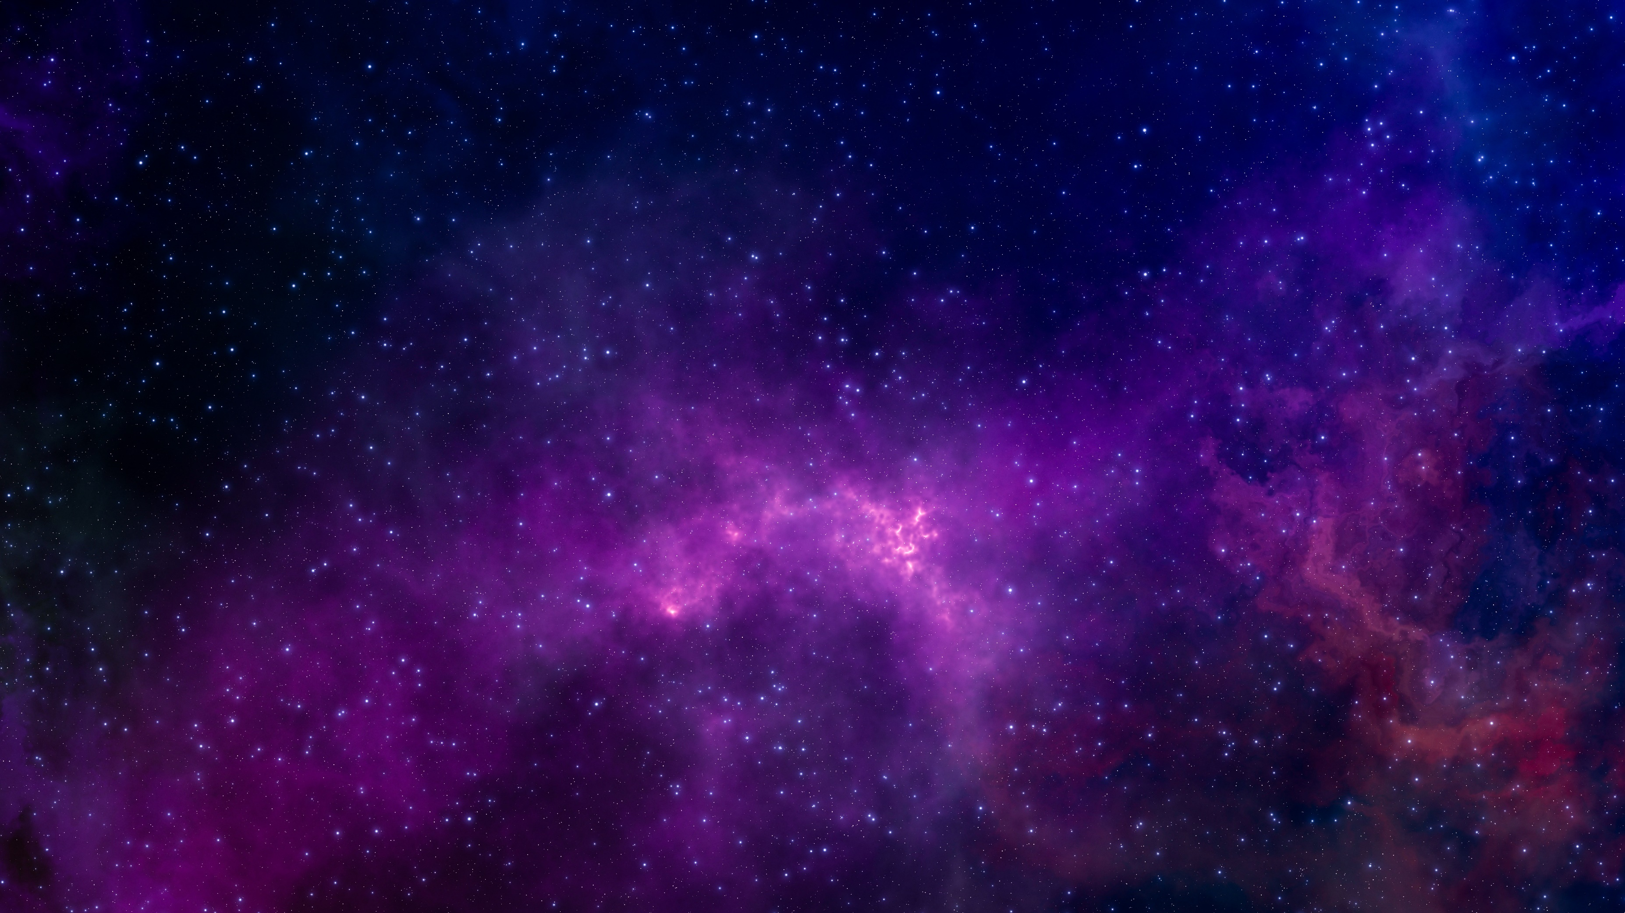
TESTING
We help our clients avoid system bugs, UX issues, and a whole host of seemingly small errors, which, if left untreated, could lead to larger-scale problems.

Slide 11
CONTACT
hello@nebulosa.io
+52 1 55 7876 6268

